Slide 1
Multiple Linear regression

Slide 2
What is the use of your model
How are inputs x related to response y
To best predict the response variable
Which input best predict the response

Slide 3
Problems in MLR
Linear relationship does not exist
Co related errors
Non constant Variance
Outliers that hurt the model
Multicollinearity

Slide 4
X variable
Explanatory variable
Independent variable
Y variable
Dependent variable
Response variable

Slide 5
Simple linear regression
Both x and y are quantitative variable
Y hat=b0​+b1x1

Slide 6
Multiple linear regression
both quantitative and categorical x-variables to predict a quantitative response, y variable
Y hat​=b0​+b1​x1​+b2​x2​+b3​x3​+b4​x4​ How to interpret the result
Coefficient shows the predicted increase in the response for every one unit increase in the explanatory(x) variable, holding all other variables in the model constant.

Slide 7
Categorical variable in MLR
The way that we add categorical variables into our multiple linear regression models is by using dummy variables.
When we add these dummy variables to our multiple linear regression models, we always drop one of the columns. The column you drop is called the baseline.
The coefficients you obtain from the output of your multiple linear regression models are then an indication of how the encoded levels compare to the baseline level (the dropped level).

Slide 8
.when you create dummy variables using 0, 1 encodings, you always need to drop one of the columns to make sure your matrices are full rank (and that your solutions are reliable from python).
Pd.get_dummies will always provide the column back in alphabetical order

Slide 9

To predict the price by coefficient
In order to predict the baseline category in the 1, 0 coding, you use the intercept.

Slide 10
OLS Regression Results
Dep. Variable: | price | R-squared: | 0.339
Model: | OLS | Adj. R-squared: | 0.339
Method: | Least Squares | F-statistic: | 1548.
Date: | Wed, 08 Aug 2018 | Prob (F-statistic): | 0.00
Time: | 05:45:35 | Log-Likelihood: | -86683.
No. Observations: | 6028 | AIC: | 1.734e+05
Df Residuals: | 6025 | BIC: | 1.734e+05
Df Model: | 2
Covariance Type: | nonrobust
Omnibus: | 1340.120 | Durbin-Watson: | 2.004
Prob(Omnibus): | 0.000 | Jarque-Bera (JB): | 3232.810
Skew: | 1.230 | Prob(JB): | 0.00
Kurtosis: | 5.611 | Cond. No. | 4.77

Slide 11
For every victorian house we predict a ____price increase, holding all else constant.
As compared to a lodge home, we predict a victorian home to have a higher price by _____, holding all else constant.
33.9% of the variability in price can be explained by the home style.(R-squared value)
For every victorian house we predict a _741100_ price increase, holding all else constant.
As compared to a lodge home, we predict a victorian home to have a higher price by __404000_, holding all else constant.

Slide 12

1,0,-1 encodind (saas)
in 1, 0, -1 coding, you need to multiply each categorical coefficient by -1 to get at the missing category. With this in mind, what is the predicted average price for lodges using the 1, 0, -1 coding model
(642100 x -1) + (66950 x -1) + (40400 x -1) = 305050

Slide 13
new_df['intercept'] = 1
lm = sm.OLS(new_df['price'], new_df[['intercept', 'ranch', 'victorian’]])
results = lm.fit()
results.summary()

Slide 14


Slide 15
Linearity
The assumption of linearity is that a linear model is the relationship that truly exists between your response(y) and predictor(x) variables.
In order to assess if a linear relationship is reasonable, a plot of the residuals (y - \hat{y})(y−y^​) by the predicted values (\hat{y})(y^​) is often useful.
If there are curvature patterns in this plot, it suggests that a linear model might not actually fit the data,
In the image on the next slide, these are considered the biased models. Ideally, we want to see a random scatter of points like the top left residual plot in the image.

Slide 16
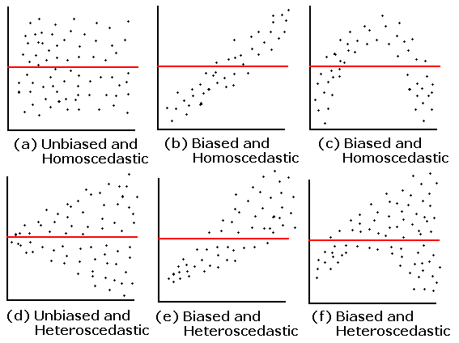

Slide 17
Corelated errors
Correlated errors frequently occur when our data are collected over time (like in forecasting stock prices or interest rates in the future) or data are spatially related (like predicting flood or drought regions). We can often improve our predictions by using information from the past data points (for time) or the points nearby (for space).
If you are unsure, there is a test known as a Durbin-Watson test that is commonly used to assess whether correlation of the errors is an issue. Then ARIMA or ARMA models are commonly implemented to use this correlation to make better predictions.

Slide 18
Non-constant Variance and Normally Distributed Errors
when the spread of your predicted values differs depending on which value you are trying to predict.
it does lead to confidence intervals and p-values that are inaccurate
Commonly, a log (or some other transformation of the response variable is done) in order to "get rid" of the non-constant variance. In or
Non-constant variance can be assessed again using a plot of the residuals by the predicted values. In the image at the bottom of the page, non-constant variance is labeled as heteroscedastic.der to choose the transformation, a Box-Cox is commonly used.
Though the text does not discuss normality of the residuals, this is an important assumption of regression if you are interested in creating reliable confidence intervals. More on this topic is provided here.

Slide 19
Outliers/Leverage Points
Outliers and leverage points are points that lie far away from the regular trends of your data
There are techniques to combat this - largely known as regularization techniques. These are beyond the scope of this class, but they are quickly discussed in the free course on machine learning.

Slide 20
Collinearity (Multi-collinearity)
When our x-variables are correlated with one another, this is known as multicollinearity.
when we have predictor variables that are correlated with one another.
it can lead to coefficients being flipped from the direction we expect from simple linear regression.
One of the most common ways to identify multicollinearity is with bivariate plots or with variance inflation factors (or VIFs).

Slide 21
One of our assumption is that x variable is related to the y variable but not with each other.
two different ways of identifying multicollinearity:
We can look at the correlation of each explanatory variable against each other explanatory variable (with a plot or the correlation coefficient).
We saw that when x-variables are related to one another, we can have flipped relationships in our multiple linear regression models from what we would expect when looking at the bivariate linear regression relationships.
For more on VIFs and multicollinearity, here is the referenced post from the video on VIFs.

Slide 22
To see the relation between x variables(bivariate plot)
Import seaborn as sb
Sb.pairplot(df[[‘area’,’bedrooms’]])
import seaborn as sns
from patsy import dmatrices
import statsmodels.api as sm;
from statsmodels.stats.outliers_influence import variance_inflation_factor

Slide 23
Variance Inflation Factors(VIF)
When VIFs are greater than 10, this suggests that multicollinearity is certainly a problem in your model. Some experts even suggest VIFs of greater than 5 can be problematic. In most cases, not just one VIF is high, rather many VIFs are high, as these are measures of how related variables are with one another.
Vif is calculated as I divided by 1 – R(squared)

Slide 24
The most common way of working with correlated explanatory variables in a multiple linear regression model, is simply to remove one of the variables that is most related to the other variables. Choosing an explanatory variable that you aren't interested in, or isn't as important to you, is a common choice.

Slide 25
Higher order terms
quadratics (x_1^2x12​) and cubics (x_1^3x13​) , where an x-variable is multiplied by itself, as well as interactions (x_1x_2x1​x2​) , where two or more x-variables are multiplied by one another.
When adding higher order terms do include lower terms as well
They are added when x and y don’t have linear relationship.
When creating models with quadratic, cubic, or even higher orders of a variable, we are essentially looking at how many curves there are in the relationship between the explanatory and response variables.
If there is one curve, like in the plot below, then you will want to add a quadratic. Clearly, we can see a line isn't the best fit for this relationship.

Slide 26
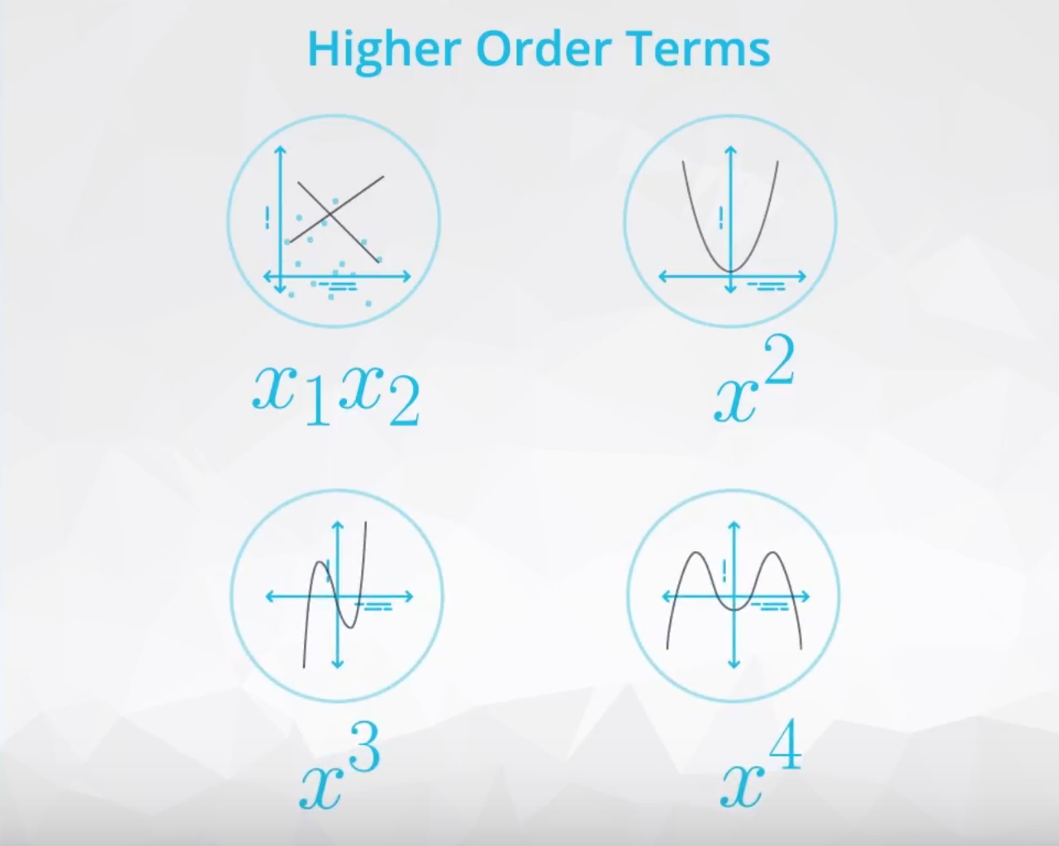

Slide 27
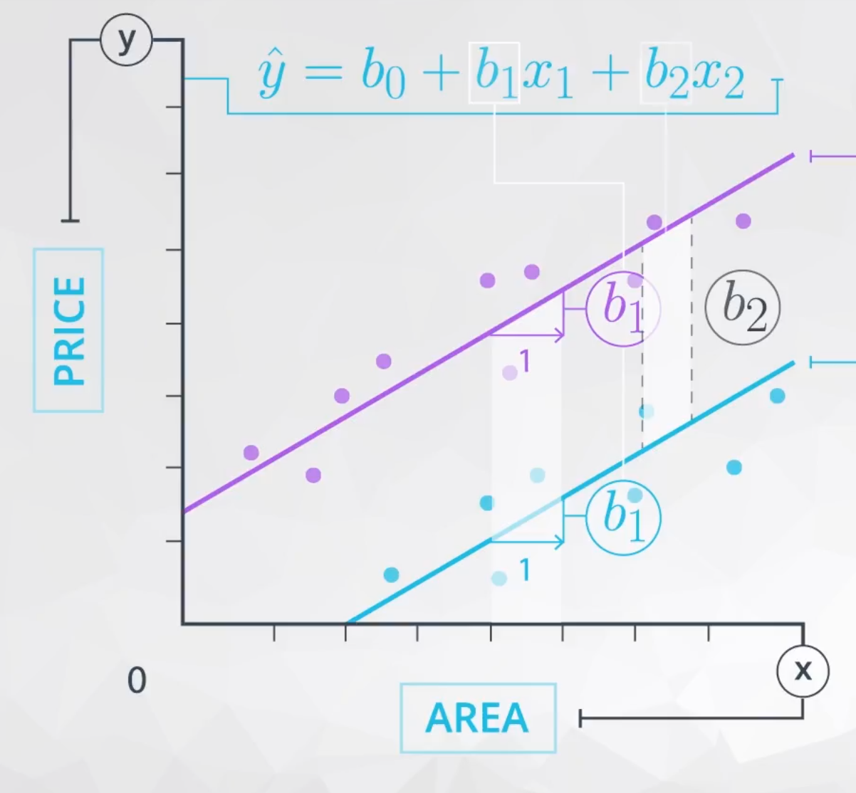
When to add interaction terms
When x is dependent on other variable say x2, to predict the y
When the value of x is related to response y and is dependent on variable x2.
When the slope is not equal to zero, we need interaction terms

